Slide 1
Onboard Status API
PREPARED BY PRECIOUS PEARL SANO

Slide 2
The client is an HR Officer need to check and update the onboard individual.
Statement of the problem

Slide 3
The mule app systems onboard consists of onboard list information inputted by HR Officer then validates if it’s pending or completed finally generated timesheet ID.
Requirement 1 of 2

Slide 4
Requirement 2 of 2
1 Flow status of all onboard pending by HR Officer ID
2 Flow status of selected onboard
3 Flow status of selected onboard cancel
4 Flow status of selected onboard validation
5 Flow generate timesheet ID and date time with submission id
6 Flow status onboard search list by HR Officer ID

Slide 5
mas-onboard
Module name

Slide 6
Endpoints/Flows
1 GET: /mas/onboard/v1/external/onboard-list Header, StatusRequest
2 GET: /mas/onboard/v1/external/onboard-load/{submissionId} Header
3 PUT: /mas/onboard/v1/external/onboard-load/{submissionId}/cancel Header
4 GET: /mas/onboard/v1/external/onboard-validation Header, StatusRequest
5 POST: /mas/onboard/v1/external/onboard-load/submission Header, StatusRequest
5 PUT: /mas/onboard/v1/external/onboard-load/{submissionId}/submission Header
6 GET: /mas/onboard/v1/external/status Header, Query params, StatusRequestView

Slide 7
Listener configuration
Protocol: HTTP
Host: 0.0.0.0
Port: 8081
Base path: /mas/onboard

Slide 8
Other Mule Components and Module
Components
Set Payload
Sub flows
Set Variable
Java
Modules
Java

Slide 9
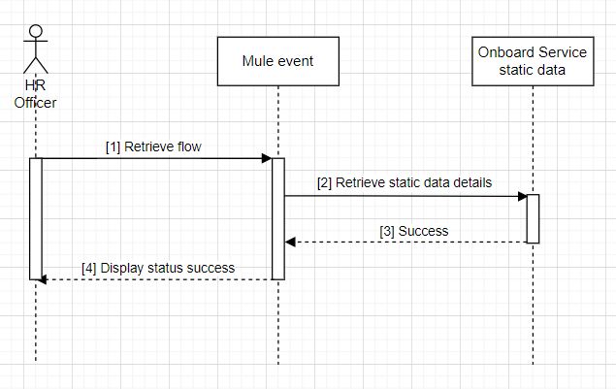
Onboard Sequence Diagram

Slide 10
Deployment Strategy
Hybrid on-premise

